Slide 1

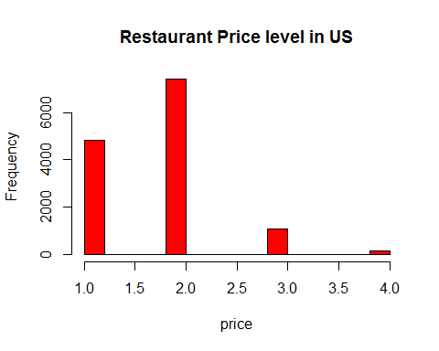
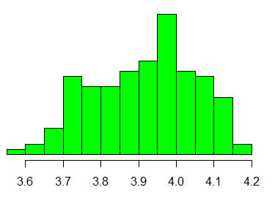
What is going on with so many Restaurants in US?
.com
by: parsing
What is the underlying statistics?
Price distribution
customer satisfaction (scale of 5)
$
$$$$
$$
$$$

